Slide 1
Predicting Flight Arrival Delay
A Data-Driven Appoach to Enchance Travel Planning
Alexey Kholodov
13 December, 2024

Slide 2

Project Overview
Problem Statement: Flight delays impact travel plans, causing missed connections and financial costs.
Key Question: How can travellers predict the likelihood and duration of flight delays with sufficient accuracy?
Data Source: U.S. Domestic Flights Delay (2014-2018) dataset from the U.S. Bureau of Transportation Statistics.
Goal: Build predictive models to estimate the likelihood and extent of delays.

Slide 3
Data Overview
US Domestic Flight from 2014-2018
30 million records and 110 features
Key Features:
Flight month, Weekday
Departure and Arrival Time Block
Airports of origin and destination
Airlines
20 features selected
12 features engineered
Dateset reduced from 81 GB to under 3 GB

Slide 4
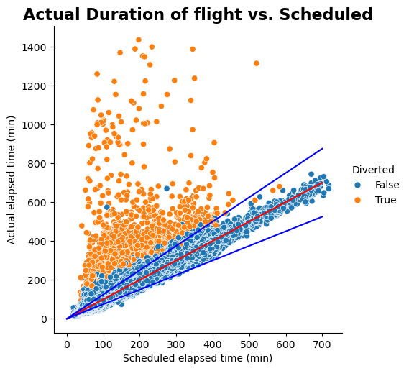
Data Cleaning
Addressed data inconsistencies:
Time zone adjustments and standardization to UTC.
Eliminated severe mismatches and outliers (<2% of data).
Optimized memory usage
Converted object data types to datetime or categorical

Slide 5
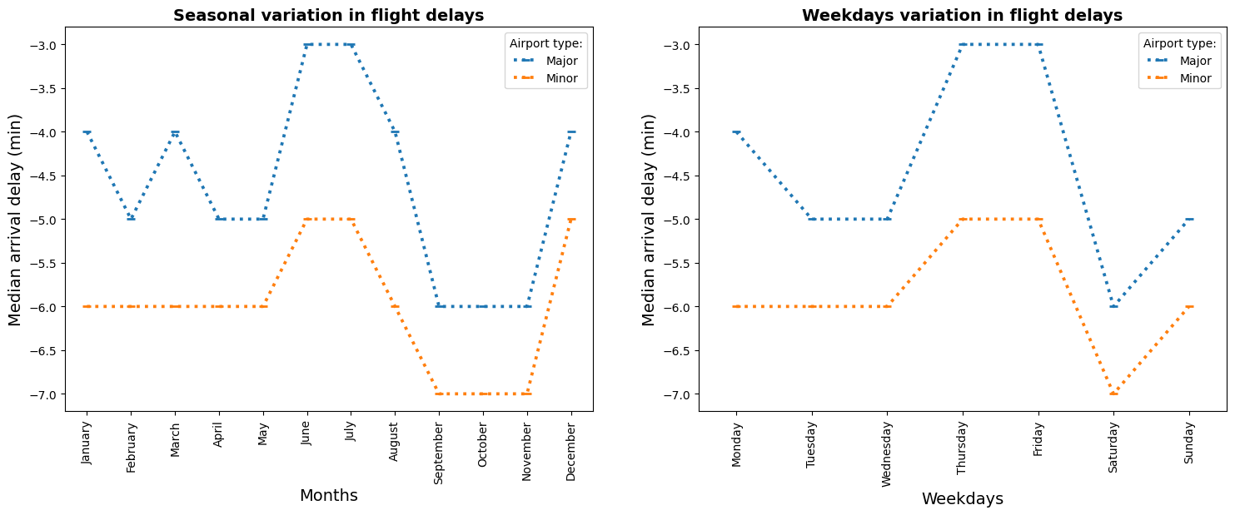
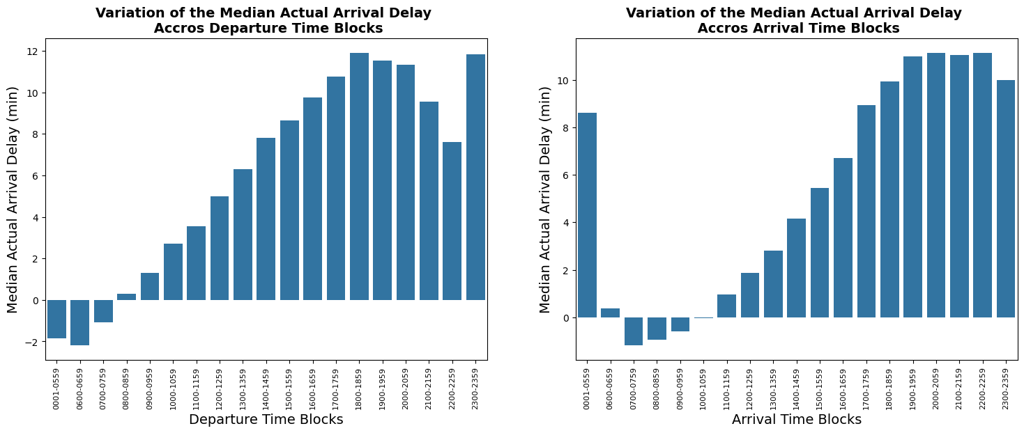
Exploratoty Data Analysis
Insights:
Graphs indicated a relationship between delays and months, weekdays, and departure/arrival time blocks.
Statistical significance was confirmed only for the relationship between delays and departure/arrival time blocks.
Non-significant findings:
No significant delay patterns by airline or airport.
Diversions and cancellations were unpredictable.

Slide 6
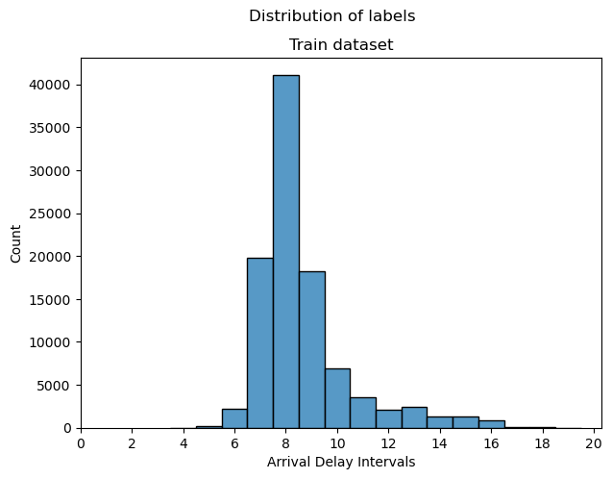
Target Variable
Regression Task: Predict actual arrival delay (minutes).
Classification Task: Group delays into 14 classes (0 to 13).
Challenges:
Target variable was right-skewed and non-normal.
Imbalanced class distribution for classification.

Slide 7
Modeling Approach
Regression Models:
Linear Regression
Lasso
PCA with Lasso
Random Forest.
Evaluation: R-squared
Classification Models:
K-Nearest Neighbors (KNN)
Random Forest Classifier.
Evaluation: F1-macro
Data spliting:
Testing data – 30%
5 folds
Hyperparameters tunning:
Random Search Cross-Validation
Greed Search Cross-Validation

Slide 8
Model Performance (Regression)
Linear Regression:
Training R-squared: 0.0251.
Test R-squared: 0.0197.
Lasso Regression:
Alpha: 0.17.
Training R-squared: 0.0220.
Test R-squared: 0.0207.
PCA with Lasso:
15 PCA factors, Alpha: 0.000001.
Training R-squared: 0.0121.
Test R-squared: 0.0122.
Random Forest Regression:
Number of Estimators: 150, Max Depth: 3.
Training R-squared: 0.0111.
Test R-squared: 0.0051.
Conclusion: Minimal predictive signal in selected features

Slide 9
Model Performance (Classification)
KNN:
Number of Neighbors: 19.
Training F1-macro: 0.073963.
Test F1-macro: 0.056446.
Random Forest:
Number of Estimators: 50, Max Depth: 20, Criterion: 'gini'.
Training F1-macro: 0.049368.
Test F1-macro: 0.037726.
Conclusion: Minimal predictive signal in selected features

Slide 10
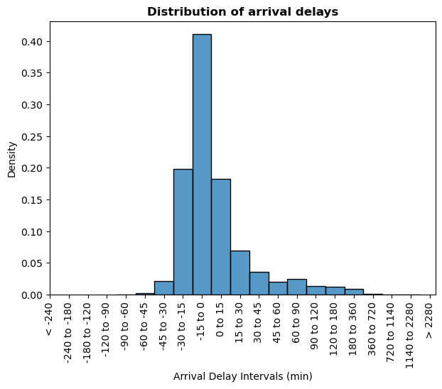
Key Challenges
Predictive features lacked strong relationships with target.
Significant external factors (e.g., weather, maintenance) were missing.
Imbalanced class distribution limited classification effectiveness.
Under these circumstances, arrival delay predictions can be estimated using the actual distribution of arrival delays.

Slide 11
Lessons Learned
Data quality and feature selection are critical for predictive power.
Understanding domain-specific complexities (e.g., airline operations) is essential.
Modeling frameworks must align with data characteristics.

Slide 12
Future Directions
Enhance Data:
Incorporate weather, maintenance, and air traffic data to improve predictions, though this may limit the model's applicability to business or professional users.
Add real-time variables for dynamic predictions, further limiting applicability and potentially shortening the forecast period.
Advanced Techniques:
Explore Gradient Boosting, Neural Networks, or Time-Series Models to improve performance.
Mitigate class imbalance using oversampling or cost-sensitive learning techniques.

Slide 13
Conclusions
Summary:
Predicting flight delays is complex due to multifaceted influences.
Current models showed limited success due to data constraints.
Impact:
Insights inform data acquisition and methodology for future projects.

Slide 14

Thank you!
Contact information:
Alexey Kholodov
Email: a.kholodov@me.com
LinkedIn: linkedin.com/in/a-kholodov

